Slide 1
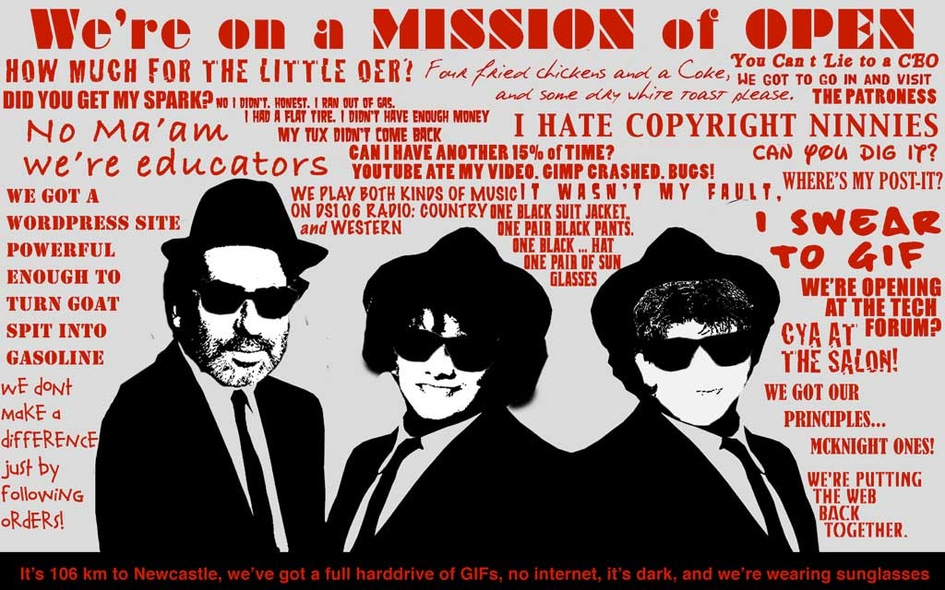
Image modified from: http://wall.alphacoders.com/big.php?i=204775
Soundtrack: Peter Gunn Theme by The Blues Brothers

Slide 2
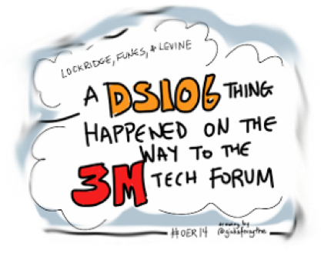
April 28-29, 2014
In Proceedings of OER14
Building Communities of Open Practice.
Newcastle upon Tyne, England.
R. Lockridge, A. Levine & M. Funes
Soundtrack: Peter Gunn Theme by The Blues Brothers

Slide 3
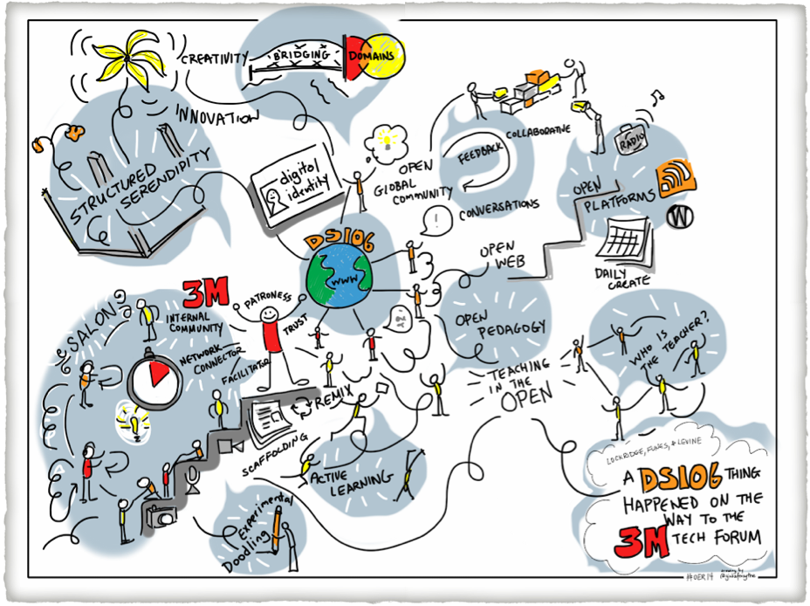
Doodle by Giulia Forsythe

Slide 4
Want to have some fun improving your 3M digital communication & collaboration skills? This is your invitation to join me in creating our first 3M DS106 Salon. Where we’ll develop our digital presence and learn the power and responsibilities that come with good digital citizenship – more important than ever as our digital lives blur between private, public, professional, and proprietary.
The goal isn’t just to learn the technology. It is to do something much larger by using these tools as resources to improve our positive impact and effectiveness inside and outside of 3M.
Invitation to Join 3M-DS106
Image by 3M-DS106 Participants Bill Dower & Rochelle Lockridge

Slide 5
But it wasn’t until I became immersed in the Headless Course that I understood how imagination powers our views of technology, and if nothing else, DS106 reminds us that the agency of creation rests with us, not our machines. We are the ones telling stories to make sense of the world.
-DS106 Open Participant Kevin Hodgson
Image by 3M-DS106 Participant Herbert Chiou

Slide 6
One of the great things about DS106, in my experience, is having people take what I’ve made and make new things from it—it’s like the ultimate validation, and it’s also like having a conversation with the other person.
-DS106 Open Participant Christina Hendricks
Image Remix by R. Lockridge

Slide 7
To see them use, especially in the DS106 area some of the technology like blogs and videos and animated GIFs was very impressive to see how quickly they went from not really using the software… to using it and feeling comfortable providing comment on how they used it. From that perspective I thought it was a very successful training session.
- 3M Technical Collaboration Chapter Chair, J. Pettinelli
Manufacturing Process
Image by 3M-DS106 Participant H. Chiou

Slide 8
I couldn’t see how these things could apply to my job, and I’ve quite a few things [from DS106] that I’ve applied to my job that I had no idea that was something that would be possible.
- 3M DS106 Participant J. Sander
Flame Ionization Detector
Image by 3M-DS106 Participant J Sander

Slide 9
...take the skill that we have and use it, instead of just generate technology - but rather to find a way to better communicating across boundaries. Those folks who are disconnected with time zones and language and cultural barriers, this type of activity has to be how we pull them into 3M, and equip them with the ability to connect.
- 3M DS106 Participant B. Dower

Slide 10
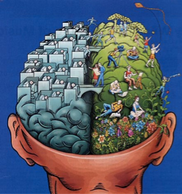
With innovation you really need both sides of the brain. You need that unstructured side, that artistic side, the humor side to mix up the logical and the technical…It’s more about creating the environment where people can innovate and have fun and get the ideas colliding.
- 3M IT Lab Collaboration Manager M. Westerham
Image by vaXzine, licensed under a Creative Commons Attribution-NonCommercial 2.0 Generic license
http://maine121.org/2011/03/14/march-17-webinar-multimodal-strategies-for-communication-and-expression/

Slide 11
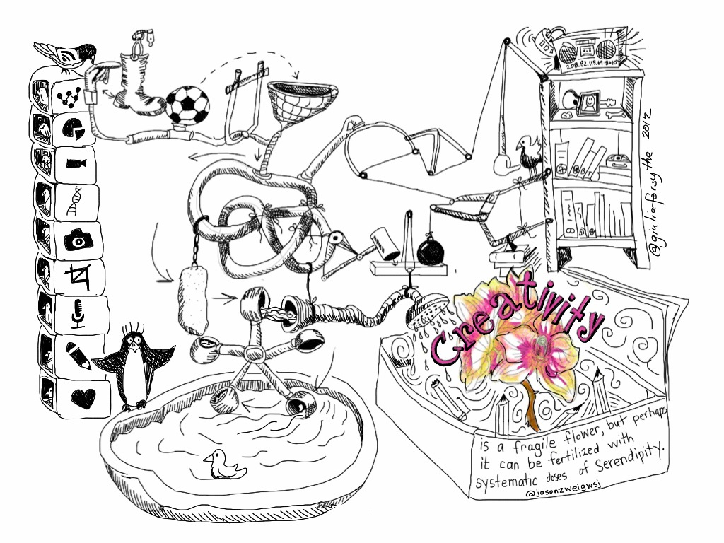
Zweig (2011) proposes that an environment of ‘structured serendipity’ may increase creative output. From a cognitive perspective, Funes (2003) research suggests creative thought has at its core ‘bridging’ activity; creativity happens at the point of discontinuity when bridging from one domain to another.
Doodle by Giulia Forsythe

Slide 12
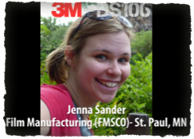
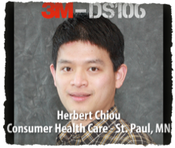
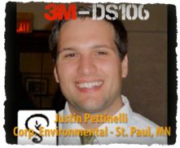
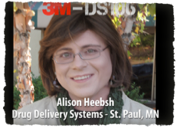
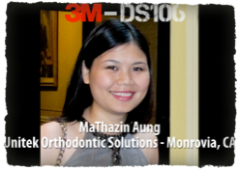
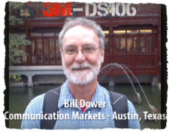
It’s been great to do it in conjunction with 3M systems so that I can immediately apply it to my job. Each of us took away a different part… but it all needs to be there because you just never know what thing might spark something and somebody else that ends up being a crucial point to their job.
- 3M DS106 Participant J. Sander

Slide 13
We need to invent a new and radical form of collaboration... it's not about 'us versus them' or even 'us on behalf of them' […] it has to be 'us with them'.
-Brown and Katz: Change by design: How design thinking transforms organizations and inspires innovation.

Slide 14
3M is a technology company. It’s our [intellectual property] that we make money on. There is a great fear of sharing that, even within 3M. So that was nice to have that internal DS106 group where they share within themselves, but then also pulling in from the outside DS106 resources to help with the internal. ..But it’s also really good to have a secured protected group within just to protect [intellectual property].
- 3M IT Lab Collaboration Manager, M. Westerham

Slide 15
Know what it is that you love doing in the whole of your life, pursue it with gusto and always assume that, no matter what it is, you can build a bridge from it to your work domain. The question to ask yourself starts with 'How can I…' and not with 'If…'
-Mariana Funes
GIF created by R.L. Lockridge with permission from M. Funes

Slide 16
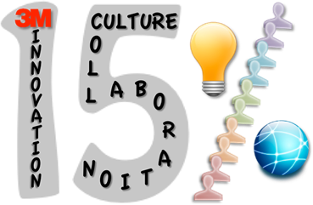
The 15 percent rule is unique to 3M. Most of the inventions that 3M depends upon today came out of that kind of individual initiative…You don’t make a difference by just following orders.
-Bill Coyne, retired 3M Senior VP of R&D
Image by R.L. Lockridge

Slide 17
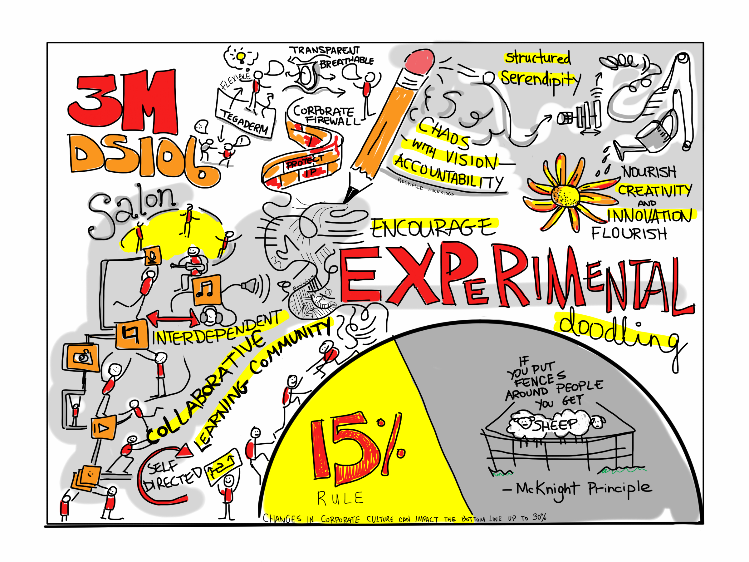
Encourage experimental doodling. If you put fences around people, you get sheep. Give people the room they need.
- William L. McKnight: 3M Chairman of the Board 1949-1966
Doodle by Giulia Forsythe

Slide 18
Image modified from: http://wall.alphacoders.com/big.php?i=204775
Soundtrack: Peter Gunn Theme by The Blues Brothers

