Slide 1

Discovering OER
Creating community specific collections in Jorum
Siobhán Burke
OER Service Manager
29th April 2014

Slide 2

Jorum’s collections
Pre-existing:
  Further Education
  Higher Education
  Re:Source
New:
  Research Data Management (RDM)
  Information and Digital Literacy Skills

Slide 3
Why RDM?
Participation in the Jisc-funded DaMSSI-ABC project
Jorum tasked to:
  create a classification scheme to improve discoverability of open Research Data Management (RDM) training resources
  deliver a sustainable ‘portal’ to showcase the resources of the Jisc RDMTrain projects resources

Slide 4

How?
6 new descriptive elements:
  Subject
  Audience
  Skill
  Ability level
  Delivery
  Range
Each with its own controlled vocabulary
Notes:
The DaMSSI-ABC project group plus some of the creators of the RDM Training resources met to discuss what elements they would like to be able to filter or search for resources on. There were many descriptive fields suggested but through a lot of negotiation, the group managed to reduce the number to just 6 additional fields
[CLICK]
And each with their own controlled vocabulary [CLICK]
Decisions about the number were due to the need to be usefully descriptive but limited so as not to make the deposit process in Jorum significantly longer and complicated. That is also why each field has its own controlled vocabulary. So when you deposit, you have a simple, multiple option drop down to choose from.

Slide 5
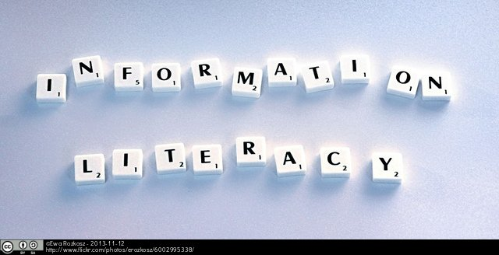
Why Information and Digital Literacy Skills?
Jorum classifications not suitable for non-subject specific OERs
Improve discoverability and description

Slide 6
How?
Survey sent to IL-OER Jiscmail list
Same 6 descriptive fields
New or additional controlled vocabularies
Skills based on Sconul 7 Pillars
Incorporated Digital Literacy Skills
Notes:
I built on the work that the DaMSSI-ABC project had done by ‘reusing’ that model. So I sent out a survey to the IL-OER discuss list asking for feedback on these fields and their vocabularies. I didn’t alter anything but allowed free text suggestions.
Audience seemed to require the most change and the Skills. So with further help from Nancy Graham and Jane Secker, who have been heavily involved with OERs in a library context gave further feedback when I had amalgamated all the feedback.

Slide 7
The Results!
RDM:
  Launched August 2013 with ~20 pre-existing resources
  April 2014: 33 resources
Information and Digital Literacy Skills:
  Launched November 2013 with ~50 pre-existing resources
  April 2014: >100 resources

Slide 8
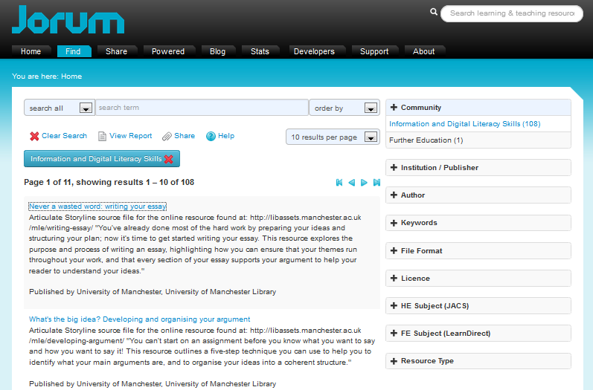
The Results!

Slide 9
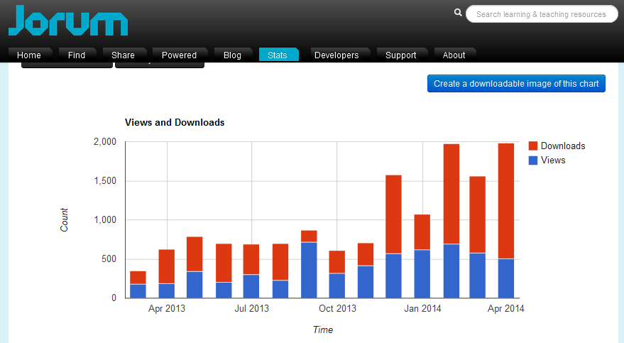
The Results!
Point 2

Slide 10
The future
More themed collections:
  Dementia
  Forensic Sciences
    In conjunction with the HEA
  Inter-professional education
    Resources that cut across health and social care
Notes:
Here are 3 that we already have in the pipeline and will be launched with existing resources from within Jorum.
We envisage more collections and we plan to display them on new look home page. This is a bit of a preview just now but were planning to launch this in June this year.

Slide 11
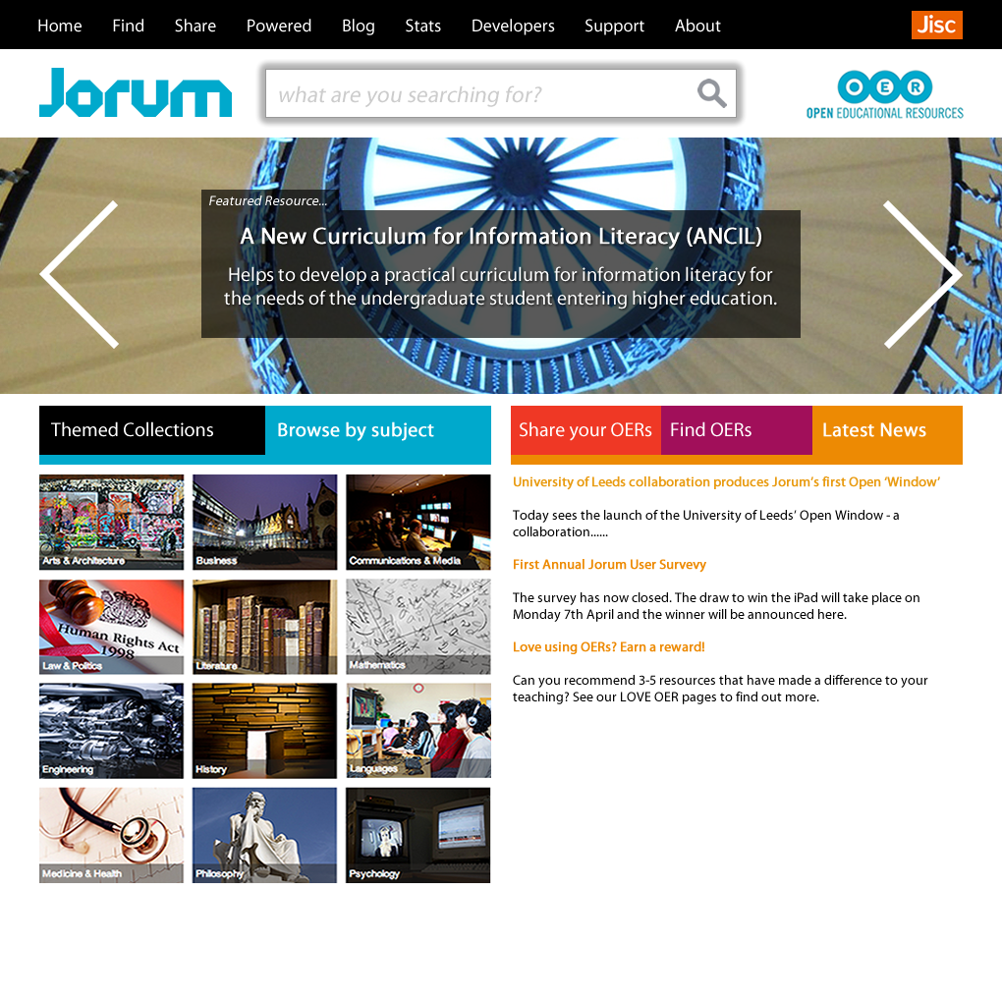
Notes:
We envisage more collections and we plan to display them on new look home page. This is a bit of a preview just now but were planning to launch this in June this year.

Slide 12
Questions/Comments?
Contact me:
Email: siobhan.burke@manchester.ac.uk
Twitter: SiobhanBurke79

