Slide 1
Building a Global Open Education Working Group
OER14, Monday 28th April 2014
PRESENTED BY
Marieke Guy

Slide 2
Open Knowledge
Promoting open knowledge in a digital age
A community-based, not-for-profit with projects and partnerships throughout the world
We build tools, apps and communities to create, use and share open data and content - information that everyone can use, share and build on
We believe that by creating an open knowledge commons and developing tools and communities around this we can make a significant contribution to improving governance, research and the economy
Collaboration not control, empowerment not exploitation, open not closed

Slide 3
http://okfn.org

Slide 4
Building a Working Group…
Overview of session
Background to the working group: why we set it up, what we hope it will achieve…
Development of the group: launch, transparent working practices, working group calls, advisory board…
Preliminary activities: Open Education Handbook, OKFestival activity, other areas of interest …
Plans for the future: How you can be involved!

Slide 5
LinkedUp Project
Linking data for Education
EU Project from November 2012 - November 2014
FP7 Support Action which “pushes forward the exploitation and adoption of public, open data available on the Web, in particular by educational organisations and institutions”
Partners: L3S Research Center of the Gottfried Wilhelm Leibniz Universität Hannover, Elsevier, the Open Universiteit Nederland and Lattanzio Learning
6 WPs: Challenge, evaluation framework, data, community, sustainability
Exploring linked open data use in education

Slide 6
LinkedUp Challenge
Veni, Vidi, Vici
3 competitions – 6 months each
Developers invited to design and build innovative and robust prototypes and demos for tools that analyse and/or integrate open web data for educational purposes
Veni Competition June 2013 – September 2013
Vidi Competition November 2013 – May 2014
Vici Competition June 2014 – October 2014
Use cases, focused tracks, real-world examples
LinkedUp catalogue – collated data sets

Slide 7
Using Open Data
...to meet educational needs
By supporting students
New tools, enriching resources, exploration, informed choices
By supporting schools and institutions
Learning analytics, improve efficiencies, benchmarking
By supporting governments and policy
Change in policy, transparency, education reform
Notes:
By supporting students
Through creation of new tools that enable new ways to analyse and access data e.g. maps of disabled access, tools for disciplines
By enriching resources, making it easier to share and find them, and how to personalize the way they are presented
By allowing student to explore resources, concepts, ideas and objects in various areas
To make informed choices on education e.g. by comparing scores, course data etc.
By supporting schools and institutions
Learning analytics data can help retain students
Use data can enable efficiencies in practice e.g. library data can help support book purchasing
Benchmarking and performance measuring
By supporting governments and policy
Open data can lead to change in policy
Open data can lead support transparency & enable efficiency
Data on equity and equality issues (3rd world countries)
Education reform

Slide 8
Open data that comes out of education institutions
Open data that can be exploited/used by education institutions
Open data that can be exploited/used by education
Open data…
Open Education Pie
Notes:
Pundit

Slide 9
Why a Working Group?
Reasons for development of the group
We wanted to see open data in education pulled into the wider debate around open education
Opportunity to bring together silos of activity: content and OER, OEP, open policy, licensing, data, tools…
Allow us to collaborate with people across sectors and globally – get the bigger picture
Where can open data in education lead? All possibilities still exist
Community building compliments what we are doing

Slide 10
Lobbying Transparency
Open Transport
Open Sustainability
Open Spending
Open Science
Personal Data and Privacy
Public Domain
Open Bibliography
Open Humanities
Open Access
Open GLAM
Open Design and Hardware
Open Linguistics
Open Government Data
Open Definition
Open Archaeology
Open Economics
Open Development
Open Product Data
Open Education
Working Groups

Slide 11
…established to bring together people and groups interested in open education. Its goal is to initiate global cross-sector and cross-domain activity that encompasses the various facets of open education.
Open Education Working Group

Slide 12
http://education.okfn.org

Slide 13
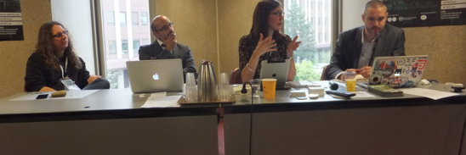
The Group Launch
At OKCon, Geneva, September 2013
Facilitated by Doug Belshaw, Badges & Skills Lead, Mozilla Foundation
Panelists:
OER perspective: Jackie Carter, MIMAS, University of Manchester
Open practitioner perspective: Davide Storti, United Nations Educational, Scientific and Cultural Organization (UNESCO)
Open data perspective: Mathieu d’Aquin, LinkedUp
Largest global open knowledge conference
Ran an open education panel session with over 100 attendees
Group officially launched

Slide 14
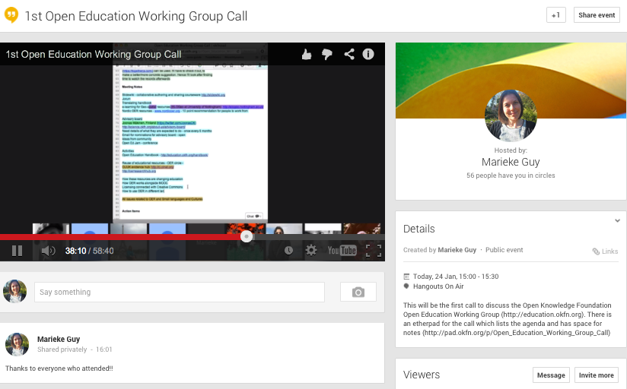
Transparent Working
“Eat your own dog food”
Website/blog, open education around the world posts
Working Group calls
Membership charter
Discussions on group mission
Call for advisory board members
http://education.okfn.org/

Slide 15
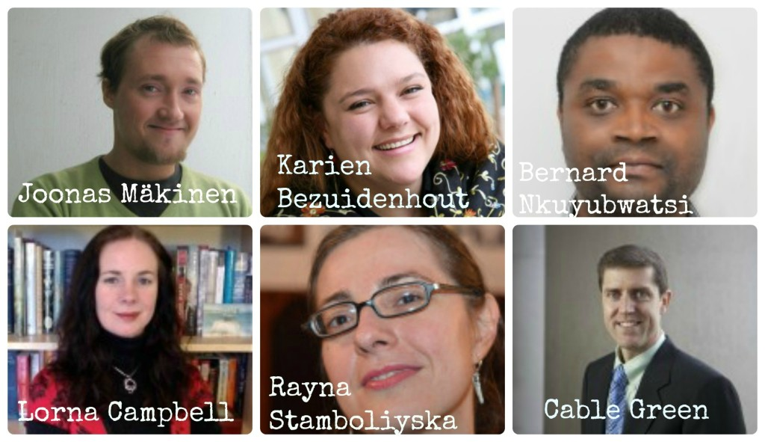
Advisory Board
Notes:
Karien Bezuidenhout, Chief Operating Officer at the Shuttleworth Foundation
Lorna M. Campbell, Assistant Director of the Centre for Education, Technology and Interoperability Standards
Dr. Cable Green, Director of Global Learning at Creative Commons
Joonas Mäkinen, Finnish maths teacher carrying out exciting open text book work
Bernard Nkuyubwatsi, initiator of the Open Education Rwanda Network
Rayna Stamboliyska, founder of RS Strategy and OpenMENA

Slide 16
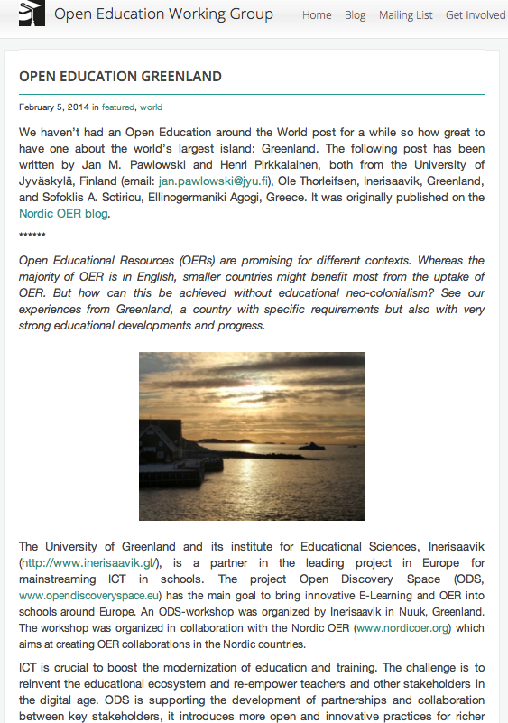
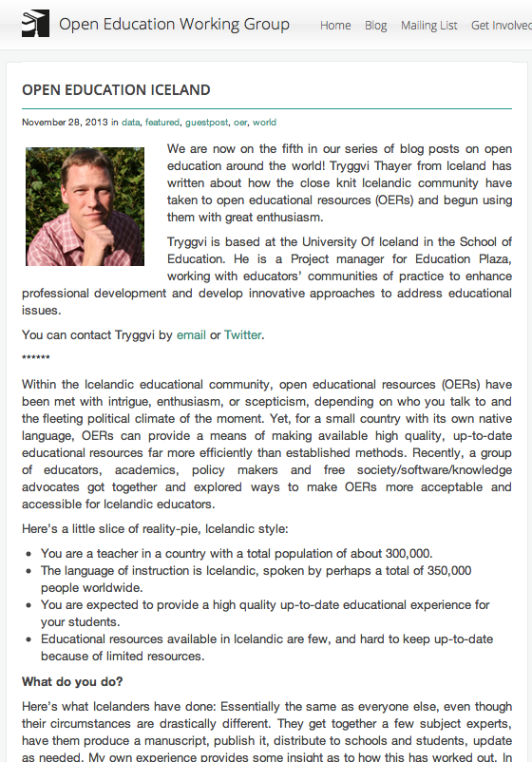
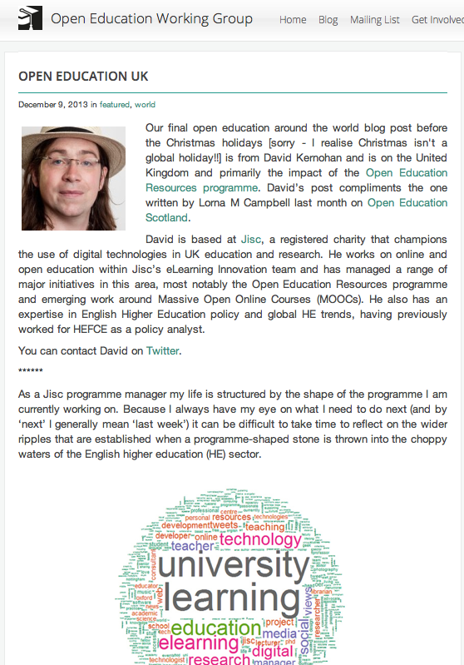
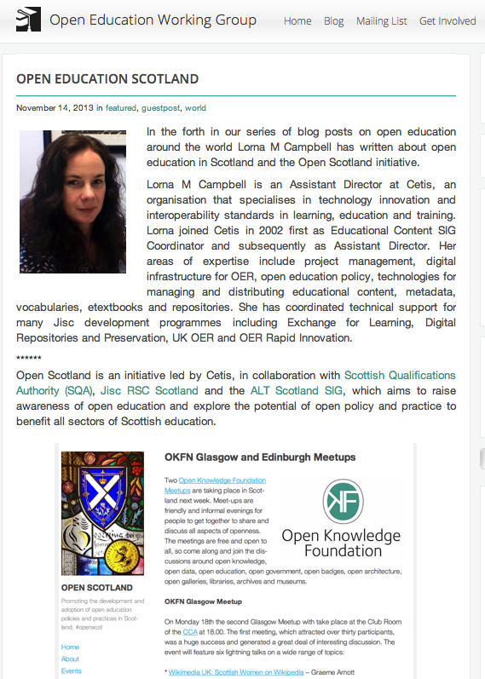
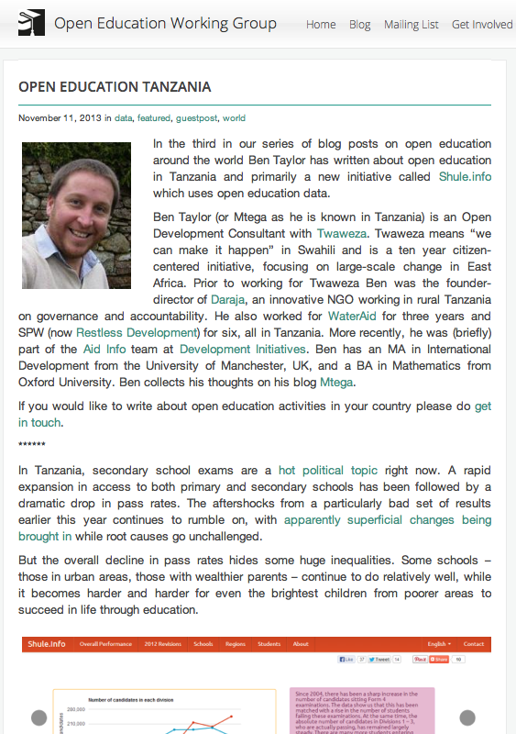
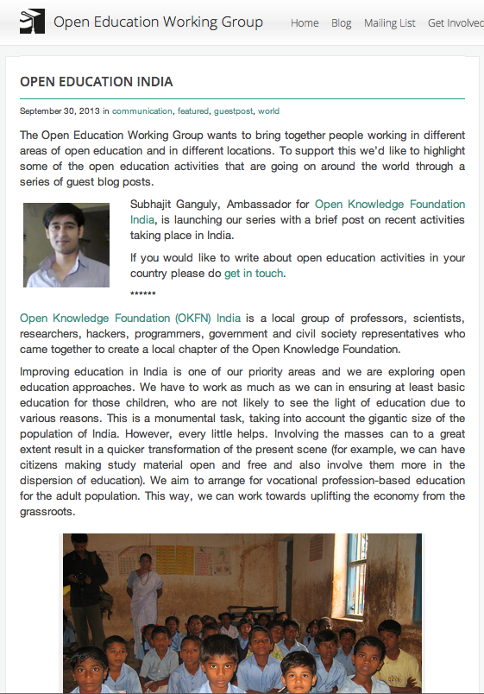
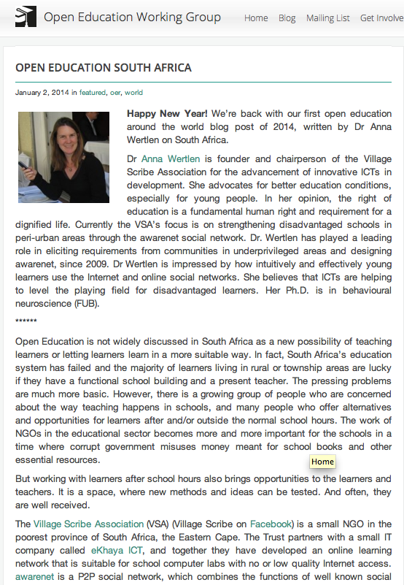
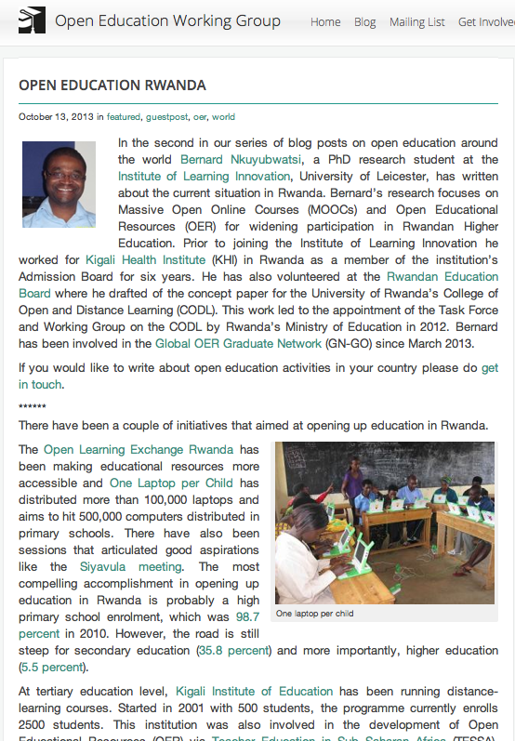
Open Education Around the World
Series of posts
Greenland
Iceland
United Kingdom
Scotland
Tanzania
India
South Africa
Rwanda
Holland …

Slide 17
General Activities
Areas of interest and ideas
Community building – making contact
Open Education timeline
OKFestival, July, Berlin – Open Education Maker Party
Support for LMRI initiatives, standards, platform for Open Standards work
OER and small languages and cultures (multilingualism)
Open Education language – making it appropriate for all
Support for member activities e.g. Open Data Ireland booksprint
Connections with local groups: Belgium, Finland, Brazil

Slide 18
Activities: Handbook
The Open Education Handbook
A collaboratively written living web document targeting educational practitioners and the education community at large
Coverage is broad and determined by authors
Kick-started at a series of booksprints and events
Available online for editing in Booktype, open source book editing software
Translated in to Portuguese, set on Slidewiki
Future plans: glossary, universal style, definitions, synergies between areas, flow, fact checking, more questions, front end

Slide 19
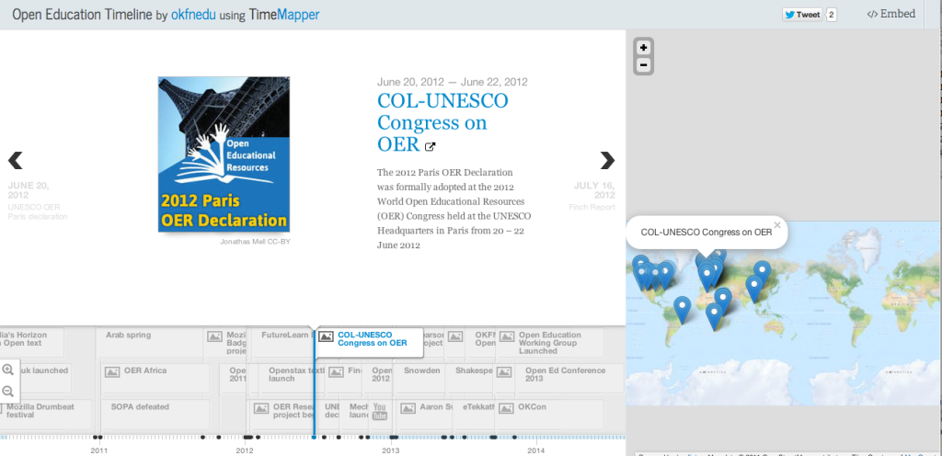
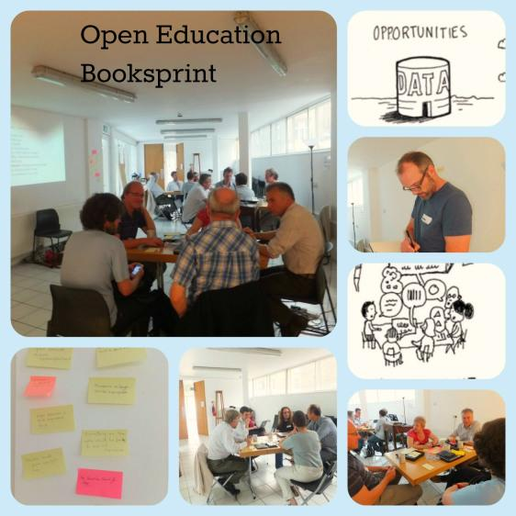
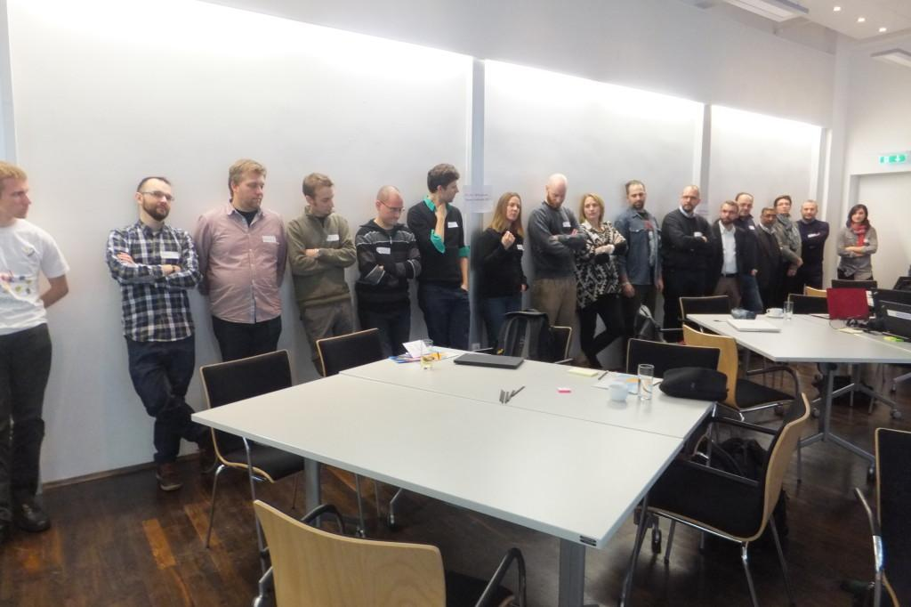
Booksprints
Notes:
First activity of Working Group
Deliverable for LinkedUp Project
Collaboratively authored
Booksprint #1 London
Booksprint #2 Berlin
Open Ed Timeline event
Now on Booktype
Looking at synergies betweenareas
Translation into Portuguese
andbook Writing Process
Introduction
Open Educational Resources
Open Textbooks
Open Licences
Open Badges
Open Learning and Practice
Open Data
Open Policy
Additional Information
Licence
Glossary
Acknowledgements

Slide 20
Plans for the Future
Growing organically…
Listening to the community and following up in directions where they feel there is a gap and we can help
Linking with other organisations and initiatives
Creating a members group
Making myself redundant!!
You can:
Join our mailing list: http://education.okfn.org/mailing-list/
Join our next call: Monday 12th May 4:30pm - 5:30pm GMT
Email me: marieke.guy@okfn.org

